Slide 1


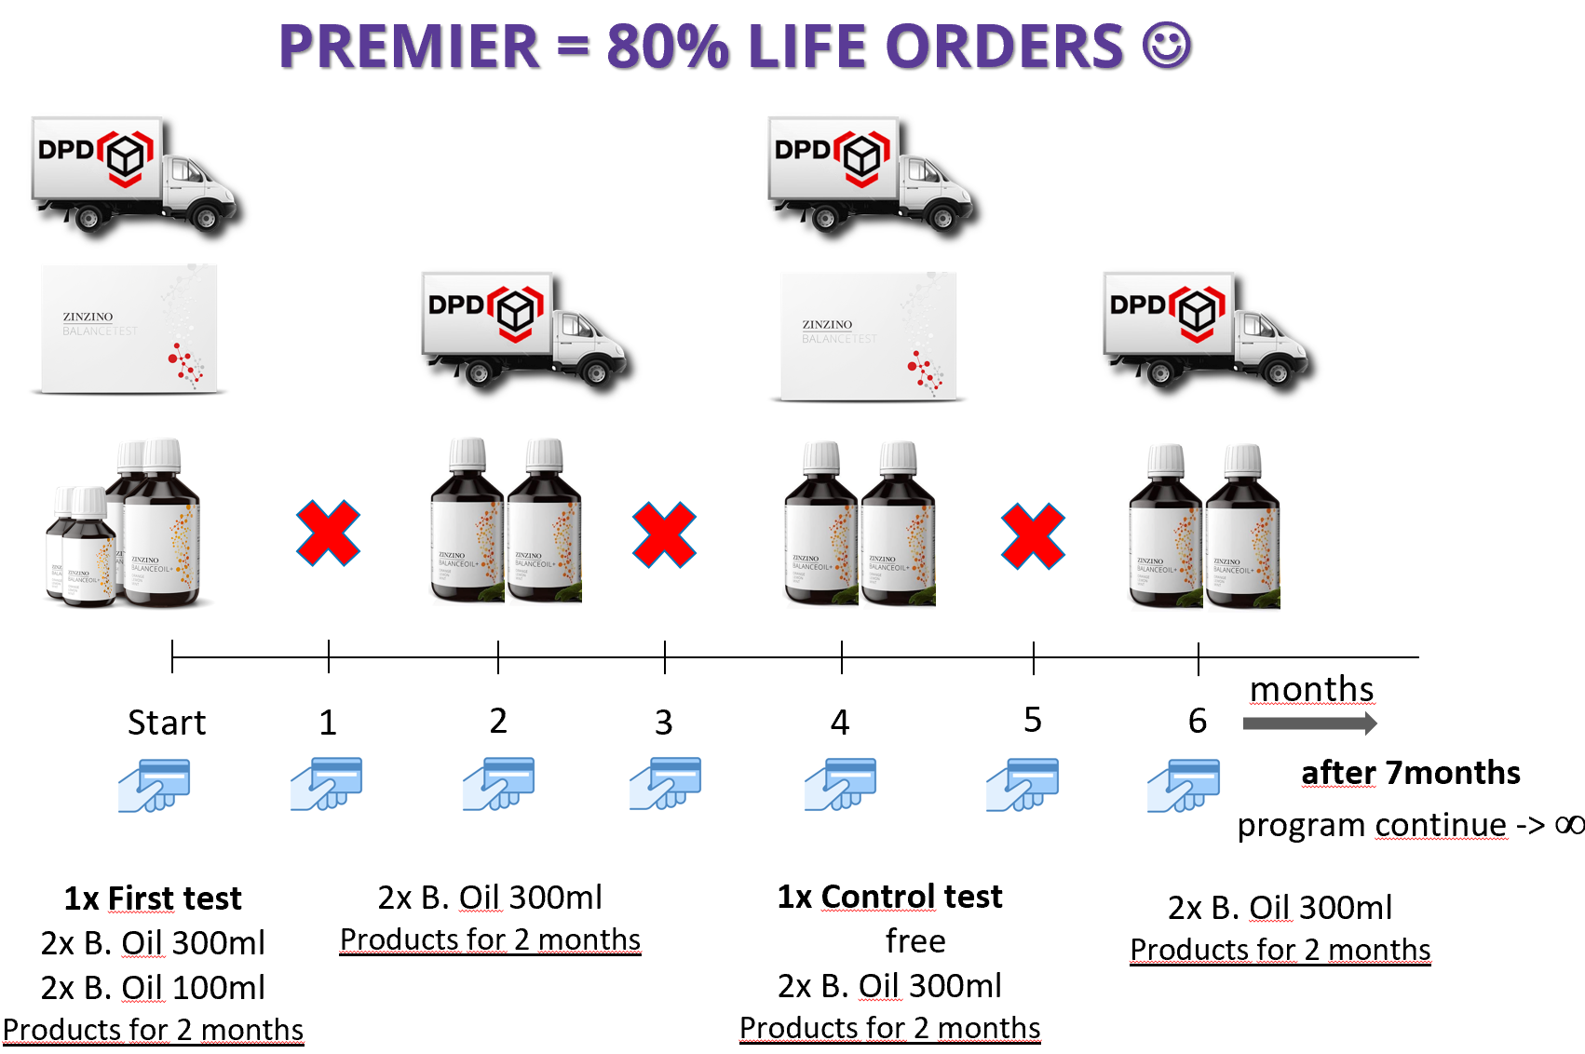
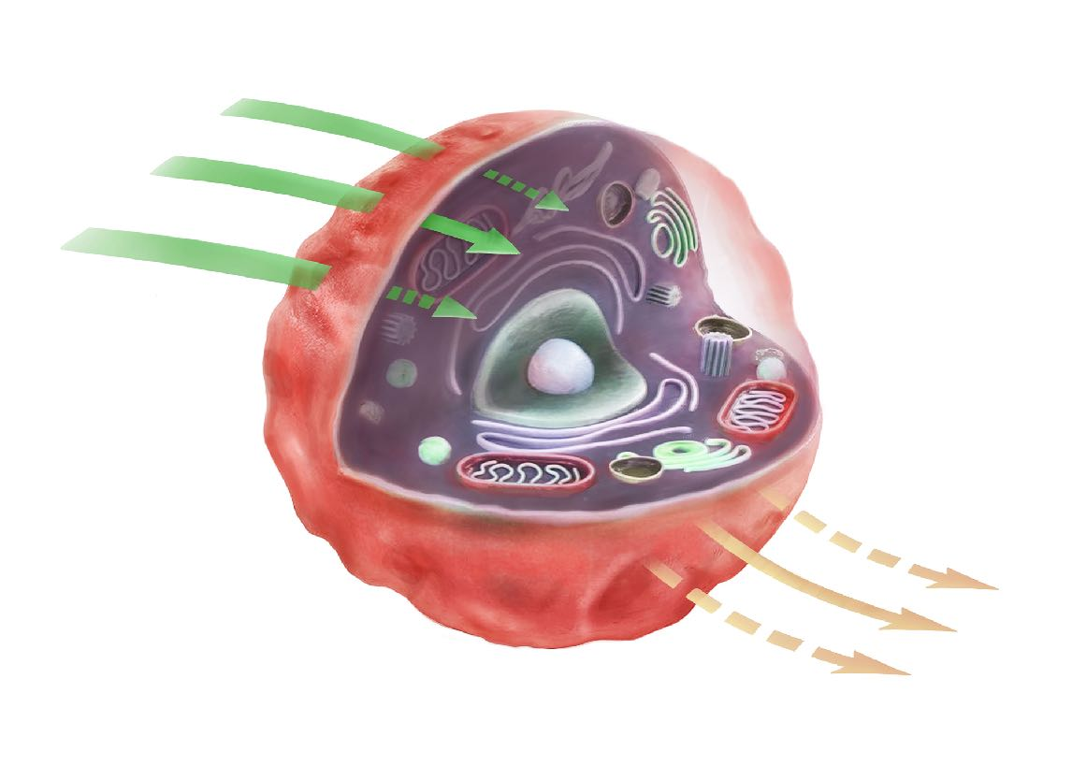

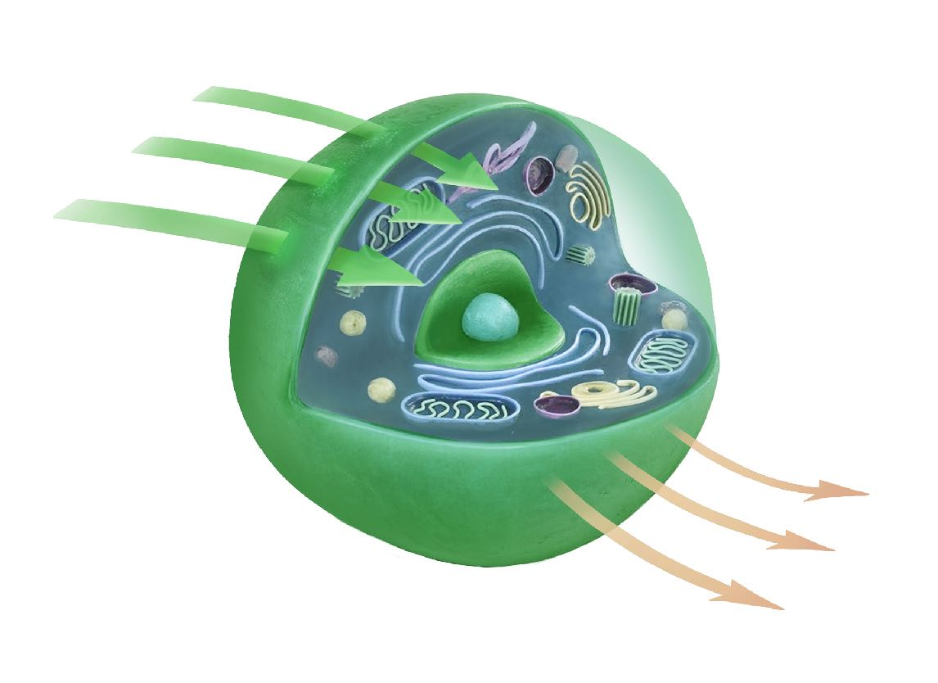


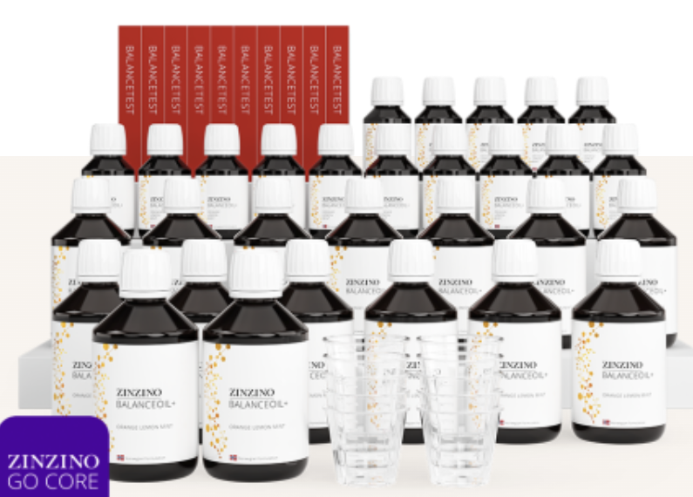
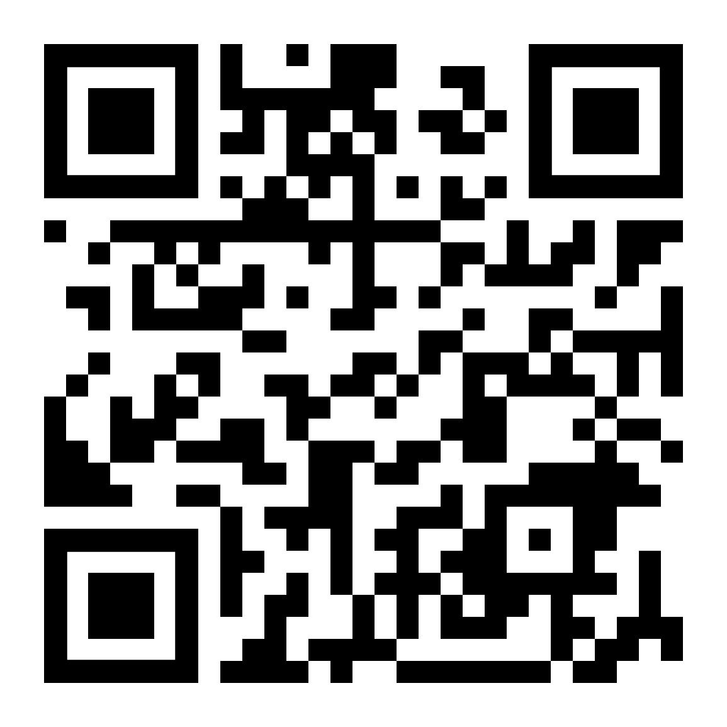

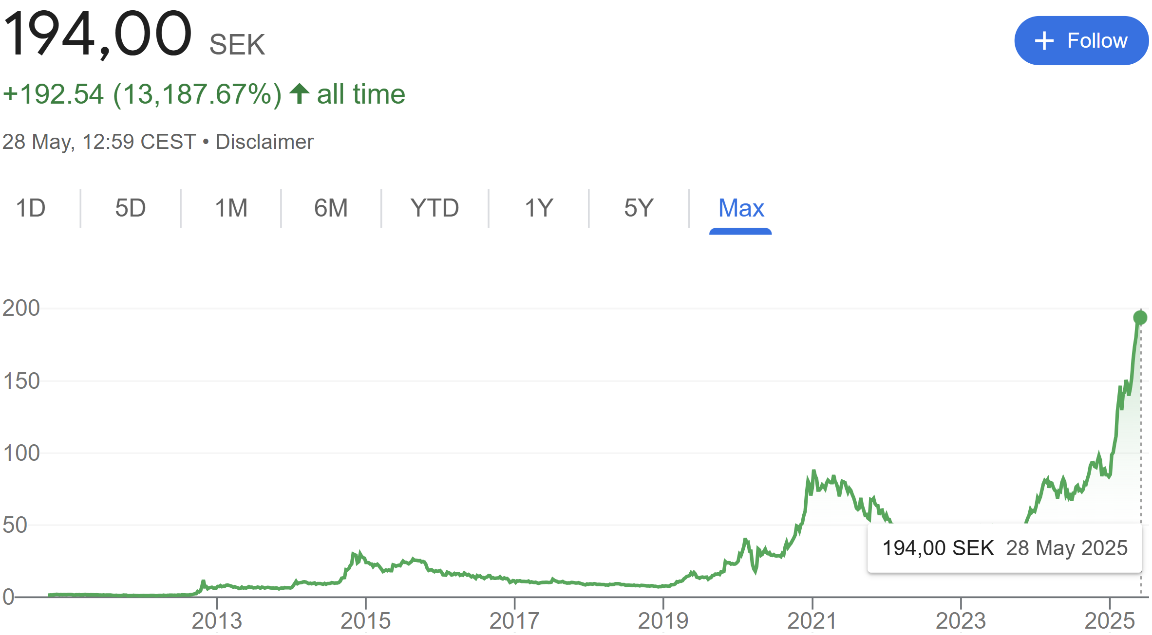
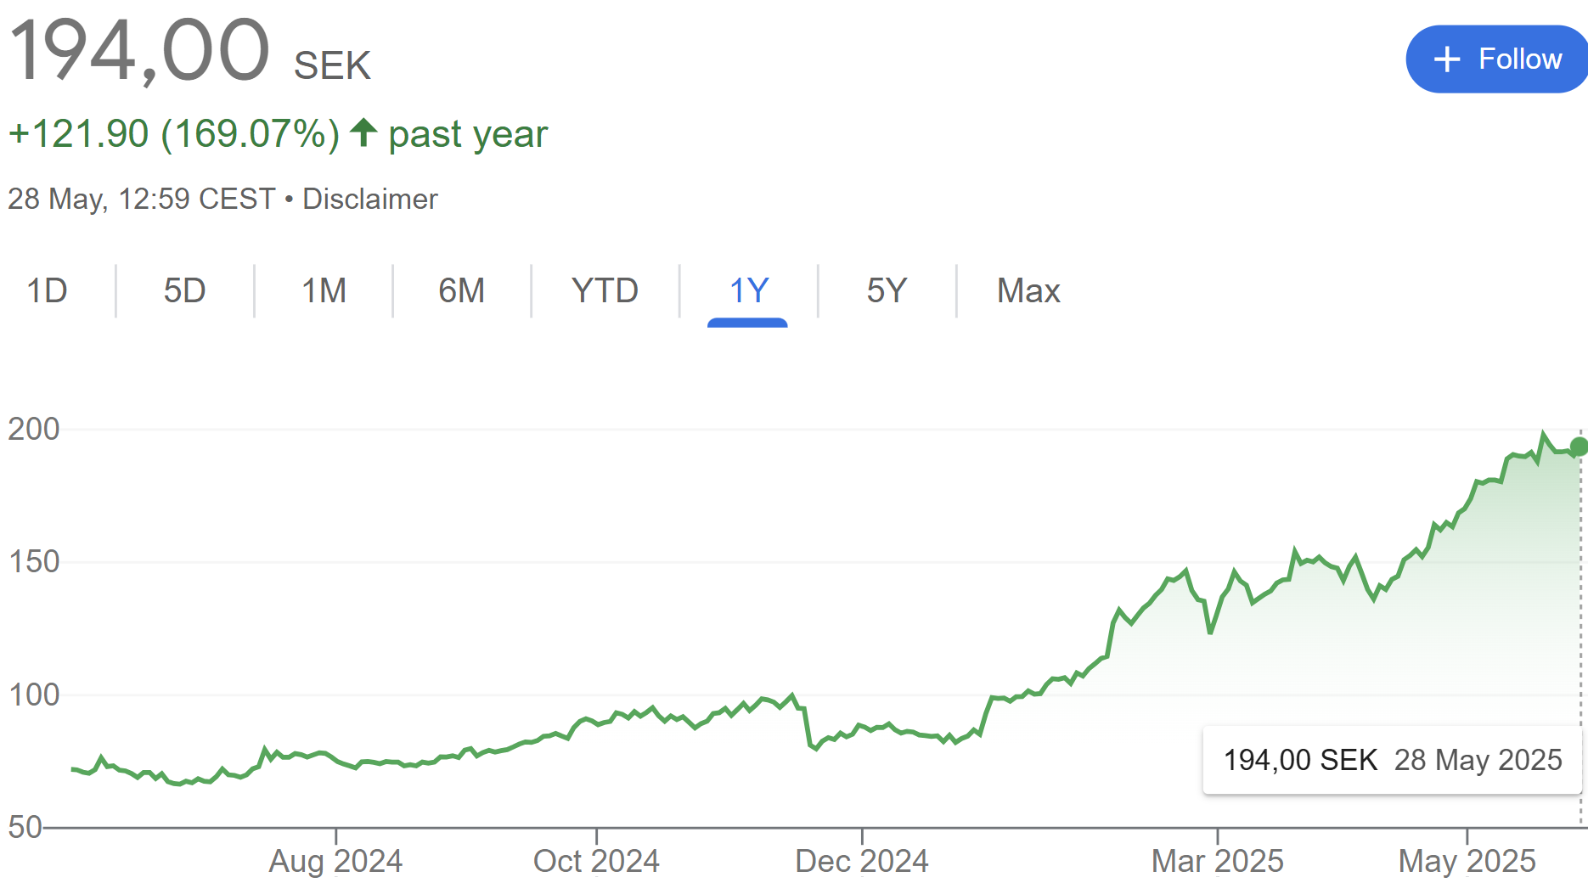

95% RETESTED PEOPLE 3:1 BALANCE IN 120 DAYS ☺
DO YOU KNOW BALANCE CONCEPT?
97% TESTED PEOPLE 15:1 DISBALANCE ☹
OMEGA BALANCE IN CELLS
=
NUTRIENTS ABSORPTION❤️
204€ PREMIER
1 TEST + 1 FREE FOR CHECK UP 2 MONTHS product suply of B.OILS MONEY BACK GUARANTEE = OMEGA BALANACE 3:1
42€ MONTHLY
EVERY 2ND MONTH delivery of 2 B.OILS
ZINOCASH –delivery cashback+10% from 7th.month
Z4F – referral 4x42 € = own product FREE EVERY MONTH
Ω6 vs Ω3 | 3:1 BALANCE = INTERNATIONAL MEDICAL NORM NAME OF TEST Ω3 INDEX / CERTIFIED DBS METHOD
BALANCEOIL+ = Ω3 IN OLIVE POLYPHENOLS
CUSTOMER POINTS PLAN
(1 C.P. = 1 PRODUCT)
PROFIT 1-200 TOPTEAM + BONUSES
1169€ UPK
10*TEST
15*300ML + 15*100 B.OIL
1 - 24 C.P. = 10%
Income + Products + Bonuses
7000 € 10-30% COMMISSION
25 | ATEAM = 20%
100€ + 100€ UPK REFUND
12000 € ANNUAL INCOME
12600 € ANNUAL Z4F PRODUCTS
50 | PROTEAM = 25%
200€ + 100€
100 | TOPTEAM = 30%
500€ OTB
400€ + 100€
10000€ OTB
15000 € OTB (DT INCLUDED)
200 | TOPTEAM = 30%
1000€ + 100€
DIRECTOR TRIP (DT)
+ OTHER BONUSES ☺
Z4F Auto Order 79€ 300ML B.OIL + TEST EVERY 4TH MONTH
WEALTH CREATION PLAN
MONEY FOR ZINZINO SHARES = PASSIVE INCOME FROM DIVIDENDS
PRESIDENT | 200 000 €
STOCK EXCHANGE
ELITE | 300 000 €
ZINZINO TOOLS
GLOBAL | 500 000 €

Slide 2

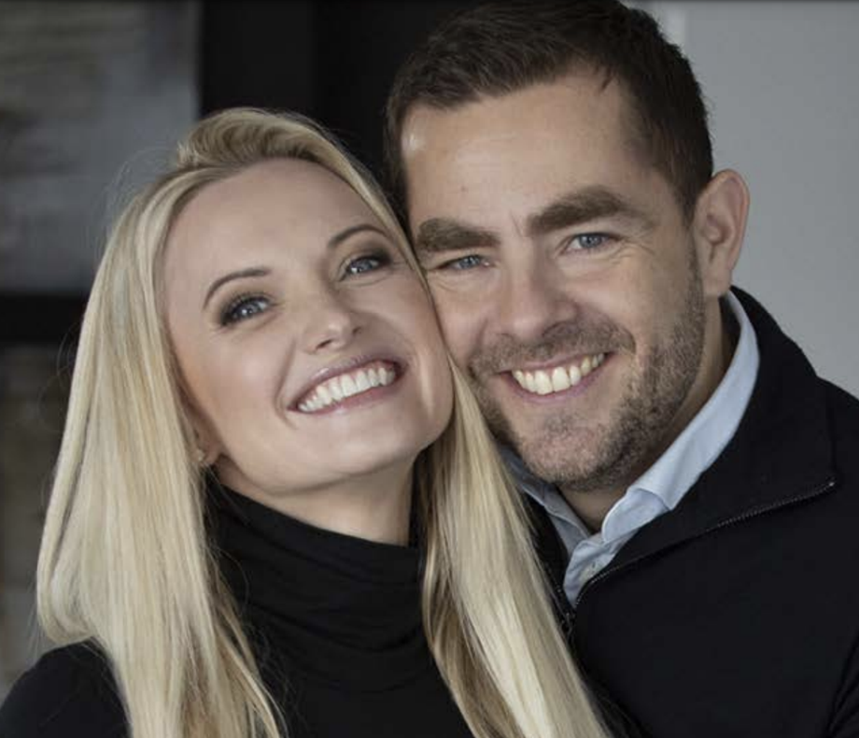
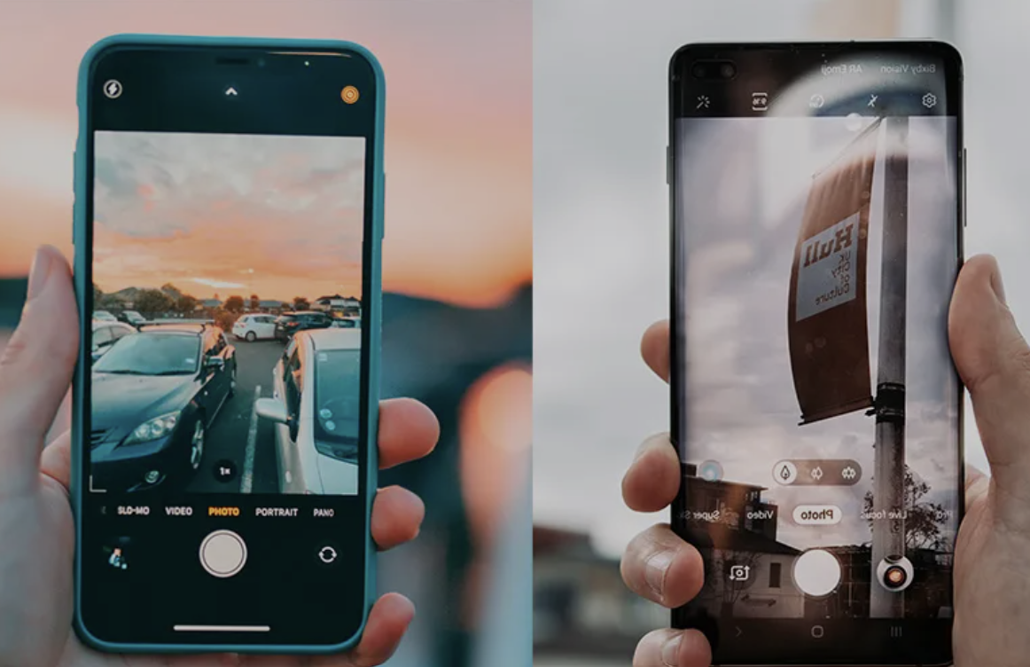
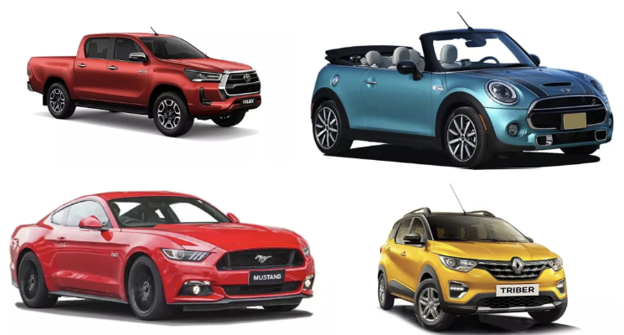

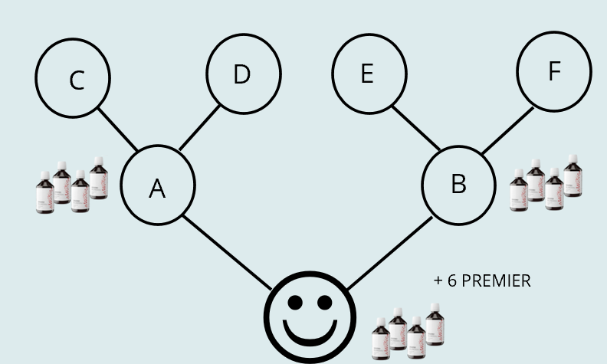
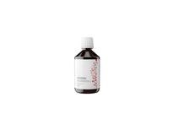

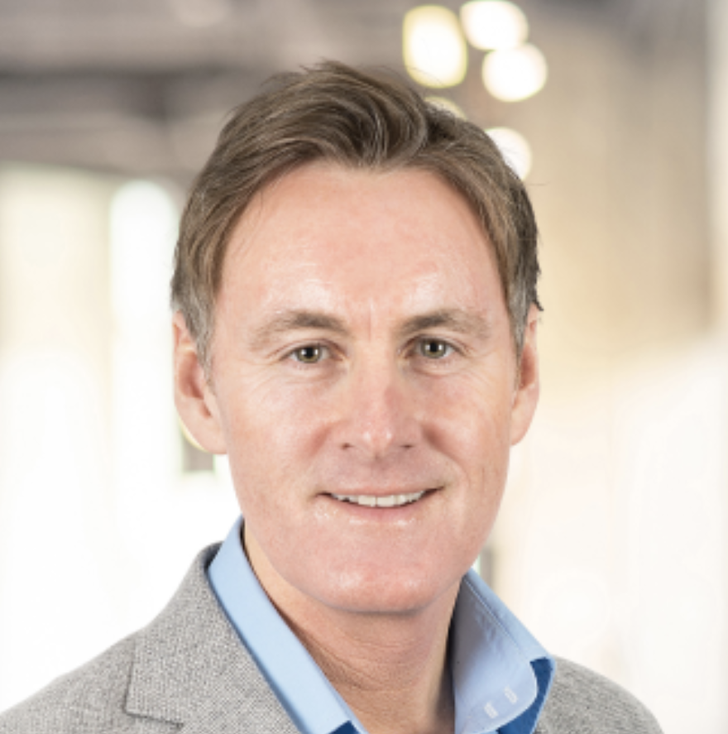
PARTNER CAREER PLAN + ROAD MAP
ATEAM/ UPK
PRO
TEAM
TOP
TEAM 100
TOP
TEAM 200
BE DIRECTOR
2X DIAMOND 2lines
MONTHLY + TURNOVER REQUIREMENTS
MONTHLY / ANNUALLY
BRONZ | 2 | 1 | 1 | 1
SILVER | 4 | 2 | 1 | 1
GOLD | 8 | 4 | 2 | 1
EXECUTIVE | 16 | 8 | 4 | 2
PLATINUM | 32 | 16 | 8 | 4
DIAMOND | 64 | 32 | 16 | 8
DIRECTOR | 128 | 64 | 32 | 16
BRONZ | 50€ | 375 CR. | 47 C.P.
SILVER | 150€ | 750 CR. | 94 C.P.
GOLD | 350€ | 1500 CR. | 187 C.P.
EXECUTIVE | 800€ | 3000 CR. | 375 C.P.
PLATINUM | 1500€ | 6000 CR. | 750 C.P.
DIAMOND | 4000€ | 12000 CR. | 1500 C.P.
DIRECTOR | 7000€ | 24000 CR. | 3000 C.P.
7000 / 84000€
4X PLATINUM 4lines
24000 CR.
9000 / 108 000€
8X EXECUTIVE 8lines
11 000 / 133 000€
WINNERS PLAN
HILDE AND ORJAN
FOUNDERS & BUILDERS
FROM NORWAY
BE PRESIDENT
4X ROYAL CROWN 4lines
50 000 / 600 000€
8X DIRECTOR 8lines
300000 CR.
100 000 / 1 200 000€
STABLE TITLE = ATEAMS NUMBER
C.P. = CUSTOMER POINT / PRODUCTS
CR. = TURNOVER CREDITS
Z4F = PRODUCTS FOR FREE
GROWTH TITLE = SOLD UPKS
REWARDS
☺ ☺ ☺
90
1.PARTNER STEP
days
UPK 1169€
Z4F 79€
PREMIER 204€
MONTHLY 42€
+ 6 PREMIER
300 CR.
FAST START
☺ ☺ ☺
60
= 2500 €
A
B
days
20 CR.
28 CR.
120
days
DAG BERGHEIM PETTERSEN CEO CORPORATE FROM NORWAY
8 CR.
C
D
E
F
30
= 3000 €
days

